Slide 1
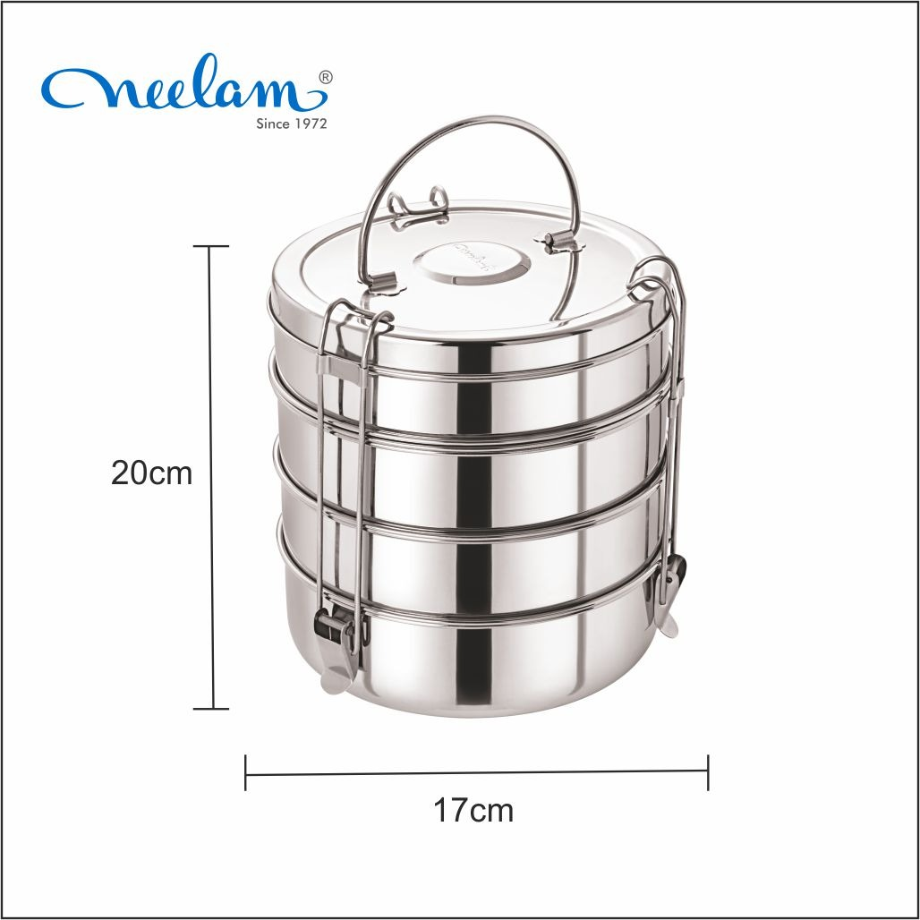
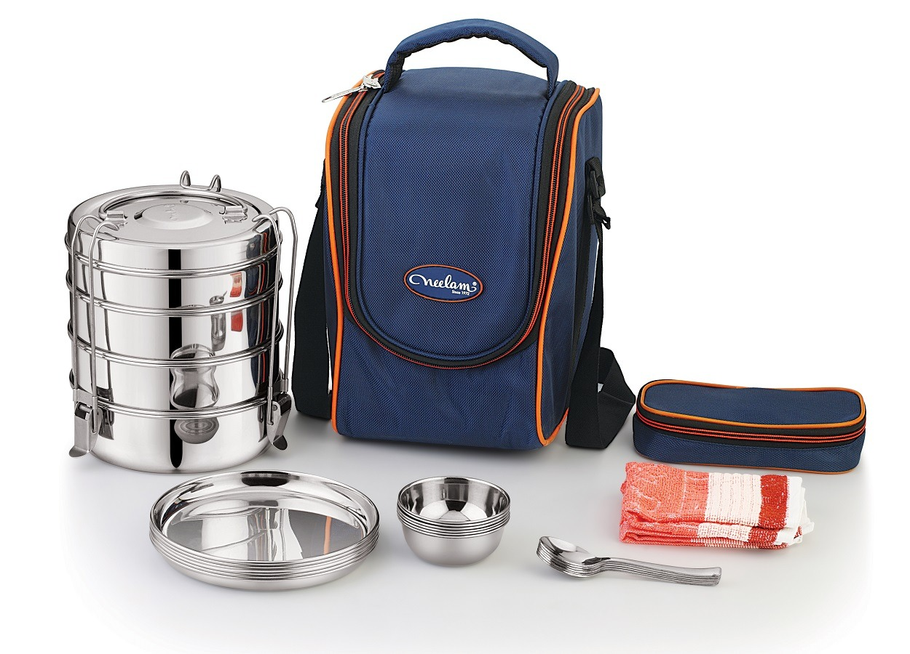

Product Of The Month – December 2024
Travelling Set
size 10/11/12
On purchase of 11 Pcs Get pcs 1 Free
MOQ -11 pcs

